Slide 1
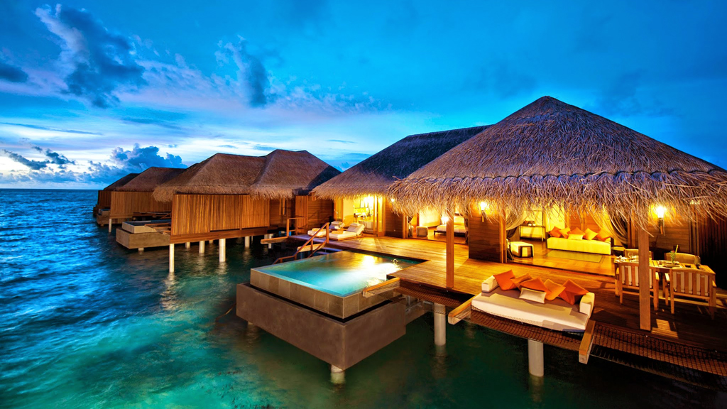
Analysis of Hotel Booking
Finding the Cancellation Reasons

Slide 2
Understanding the problem statement
Business Problem Statement: In recent years, City Hotels and Resort Hotel have seen high cancellation rates. Each Hotel is now dealing with number of issues as a result, including fewer revenues and less than ideal hotel room use. Consequently, lowering cancellation rates is both Hotels primary goal in order to increase their efficiency in generating revenue, and for us to offer thorough business advice to address this problem.
The Analysis of Hotel booking cancellations as well as other factors that have no bearing on their business and yearly revenue generation are the main topics of this report

Slide 3
Assumptions
o No unusual occurrences(No outliers) between 2015 and 2017 will have a substantial impact on the data used
o The information is still current and can be used to analyze a hotel’s possible plans in an efficient manner
o There are no unanticipated negatives to the hotel employing any advised technique
o The hotels are not currently using any of the suggested solutions
o The biggest factor affecting the effectiveness of earning income is booking cancellation
o Cancellations result in vacant rooms for the booked length of time
o Clients make hotel reservations the same year they make cancellations

Slide 4
Understandings
a) Understanding the problem from given statement: Hotel Business is facing huge loss due to high cancellation rate from customers, so we need to identify what is the main reason for customer cancelling the bookings?
b) Generating Research questions:
i) What are the variables that affects cancellation of hotel reservations?
ii) How can we reduce the booking cancellation rate?
iii) How will hotels be assisted in making pricing and promotional decisions?
c) Generating Hypothesis:
i) More cancellation occurs when price is high
ii) When there is a longer waiting list customer tend to cancel the ticket
iii) Poor quality service may lead to customer vacate the rooms earlier than reserved days

Slide 5
Analysis Report

Slide 6
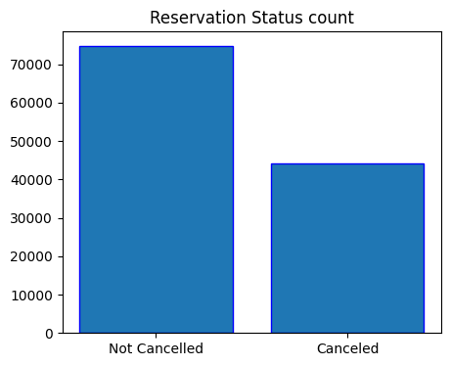
1) Percentage of Booking Cancellation
We found that around 38% of bookings are cancelled from 2015-2017. It's half of the not cancelled reservation bookings (62%), so it's high rate of cancellation. If it was around 5-10% then it's not a big problem. We need to do further analysis on what causing them to get 38% of cancellation.

Slide 7
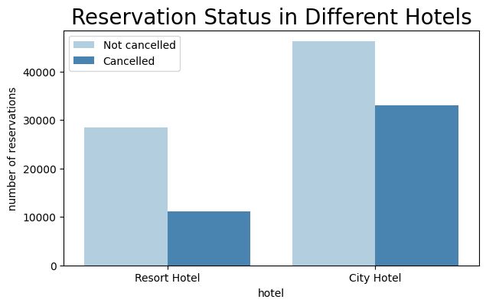
2) Total number of reservation and Cancellation by Each Hotel
Above graph shows us that City hotels getting more Bookings compare to Resort Hotels, but at the same time City hotel bookings are getting cancelled more than Resort Hotels. From the graph we can identify that City Hotels Bookings are only 58% not getting cancelled and 42% getting cancelled with comparing to Resort Hotel's not cancelling rate of 72% and 28% of cancellation rate.
So we need to identify the exact reason why city Hotel Bookings are getting cancelled and also need to identify why Resort Hotels are getting low reservation bookings.

Slide 8
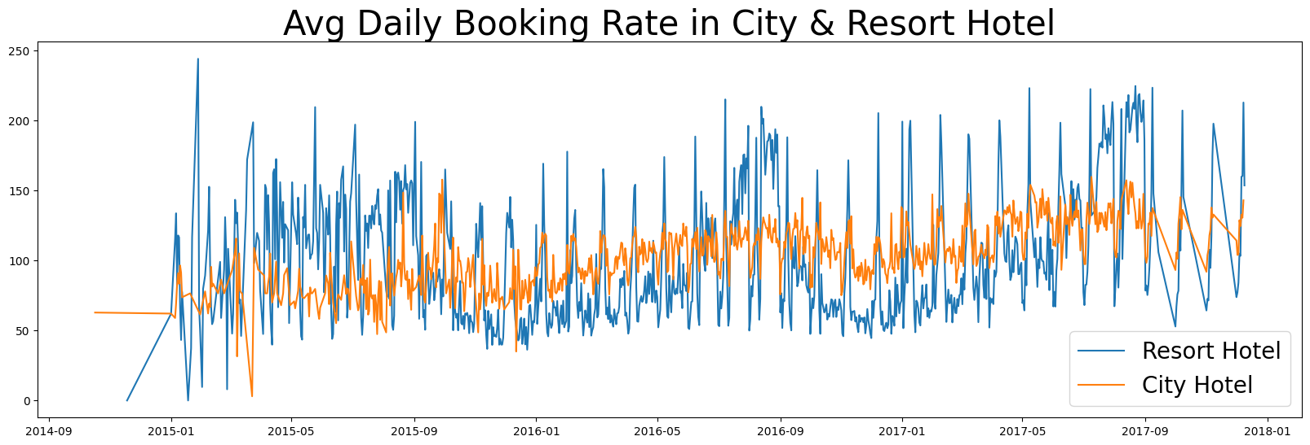
3) resort wise daily Avg booking price
This will helps us to get to know the Avg price charging by each hotels on a daily basis. So that we can identify whether variation in price will effect the cancellation?
The graph proves that avg price for booking in City hotel is much lesser than resort Hotel for most of the days. May be during Weekends and festival season price may gone up as we assuming. We need to further analyze on month wise report.

Slide 9
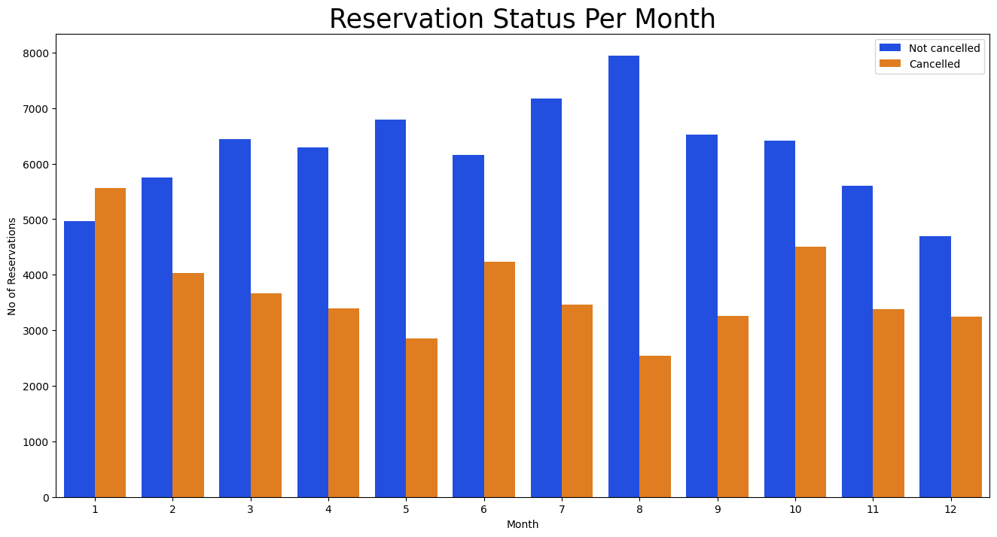
4) Month wise reservation & cancellation
From the graph we can understand that in the month of August there is a high reservation happened and in the month of Jan and Dec Lowest reservation happened. Same way In January highest number of cancellation happened and in August lowest cancellation happened. It shows that During high peak time cancellation is less and Reservation is more, while during Low peak reservation is less and cancellation is more.

Slide 10
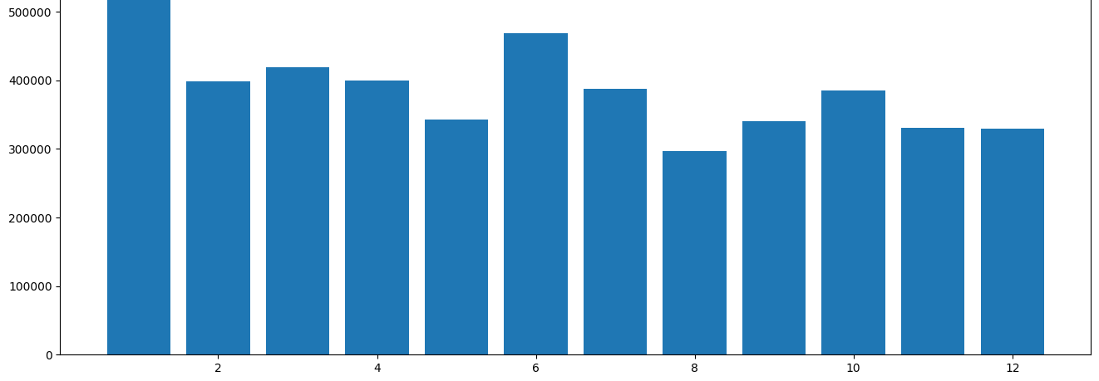
5) Avg Price per month
The Graph clearly shows that During the month of Jan and June price of reservation is High, so that most of the cancellation happened in these month and also less reservations happened in those months. It’s clearly states that when hike in the booking price reservation goes down and cancellation goes up and vice versa.

Slide 11
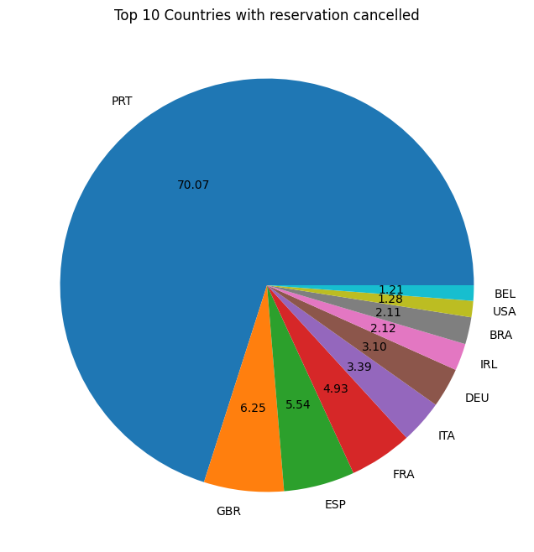
6) Top 10 Country wise Cancellation rate
To understand which country making highest booking and cancellation, so that we can understand which country we need to focus more to attract theme even better.
The pie chart shows that Portugal country is the Highest among other countries on Cancellation of Bookings around 70%. So we can suggest the Hotels to focus more on Portugal country hotels on improvising the quality of service, properly fixing the pricing, adding different dishes as per countries requirement, arranging some events where public can enjoy with fun. Running more advertises, promotional discount offers etc.

Slide 12
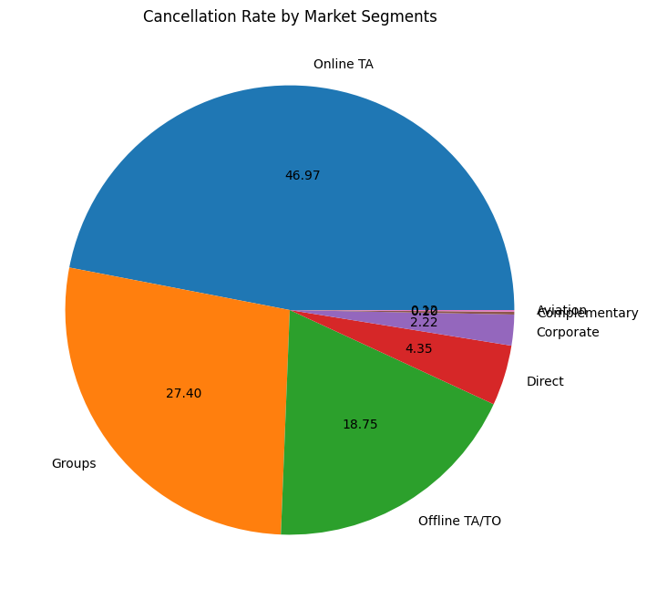
7) Market Segment wise Cancellation rate
Our Hypothesis was that people coming highest from Offline travel agencies but it’s went wrong. While calculating percentage of booking segment we got that 47% of booking is happening through Online Travel Agents.
Reason may be because of false information available in online and also the picture showing in online is different than actual hotel pictures. Facilities mentioned by online travel agencies are not available in actual hotels these are may be the problems. So Hotels need to looking into every agencies websites and their booking criteria's to understand where they are giving false info and false promises on offers.

Slide 13
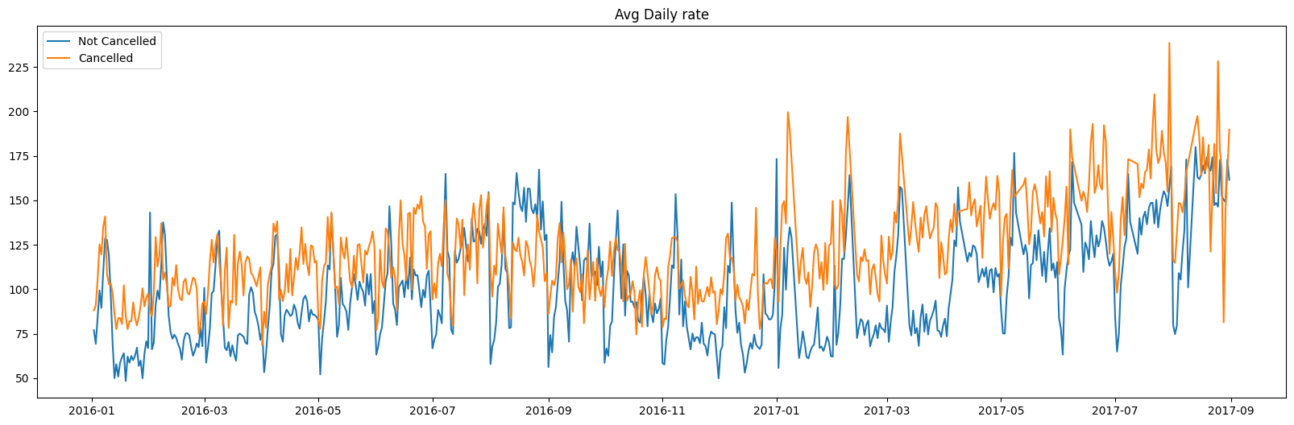
8) Avg Daily Rate of Cancelled and Non cancelledtickets
If we see the above line graph we can clearly consider that whenever price gone up tickets got cancelled and vice versa. So main reason for cancellation is pricing of bookings

Slide 14
Suggestions to the Hotel Owners
1) Cancellation rates rises when the price goes up. In order to prevent cancellation of reservations, hotels could work on their pricing strategies and try to lower the price for specific hotels in specific Countries where cancellation rate is high(refer Top 10 countries). Adding Some discounts will helps to attract many customers.
2) As the Reservation rate is High and Cancellation rate is also high in City Hotel compare to Resort Hotel, so they needs to provide some discounts and Special offers to Couples on Weekend or Holidays that can help them to get more not cancelled customers.
3) In the Month of January Hotels getting highest number of Cancellation, so they need to perform some strategic marketing campaign with some discounts and offers. This will help them to hold their customers.
4) We saw that in Portugal highest number of cancellation is happening, so to reduce that Hotels should focus on providing high quality services and adding new items in their food menu according to customer preferences and countries culture. They need to conduct some events to attract more customers.

Slide 15

THE END

